Slide 1
Introduction to Software Construction
Lecturer: Ngo Huy Bien
Software Engineering Department
Faculty of Information Technology
VNUHCM - University of Science
Ho Chi Minh City, Vietnam
nhbien@fit.hcmus.edu.vn

Slide 2

Objectives
To present what is software construction.
To present why software construction is important.
To prepare software construction prerequisites.

Slide 3

Contents
Software Construction.
Programming Languages.
Technology Stacks.
Metaphors.

Slide 4

References
Steve McConnell (2004). Code Complete. Microsoft Press.

Slide 5
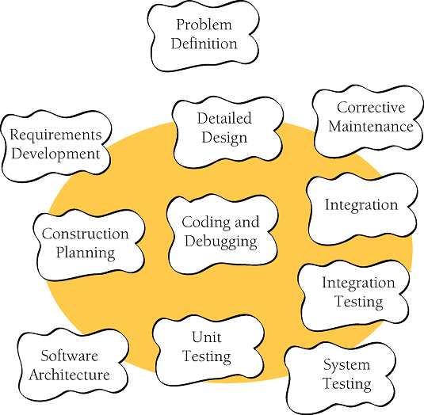
Software Construction [1]

Slide 6
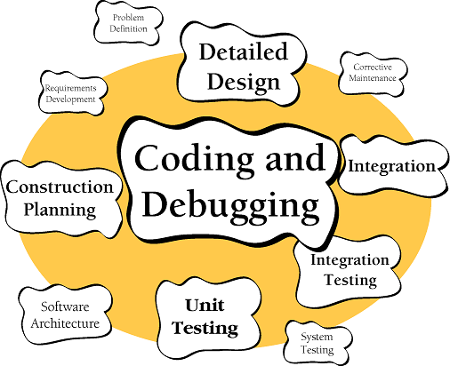
Why Software Construction?
Construction is a large part of software development
Construction is the central activity in software development
Construction's product, the source code, is often the only accurate description of the software
Construction is the only activity that's guaranteed to be done

Slide 7

Software Construction Tasks
Verifying that the groundwork has been laid so that construction can proceed successfully
Determining how your code will be tested
Designing and writing classes and routines
Creating and naming variables and named constants
Selecting control structures and organizing blocks of statements
Unit testing, integration testing, and debugging your own code
Reviewing other team members' low-level designs and code and having them review yours
Polishing code by carefully formatting and commenting it
Integrating software components that were created separately
Tuning code to make it faster and use fewer resources

Slide 8

Software Construction Prerequisites

Slide 9
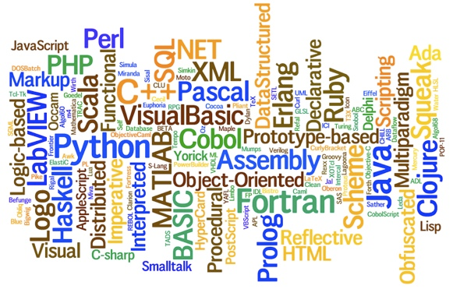

Programming Languages
Why SO many programming languages?

Slide 10
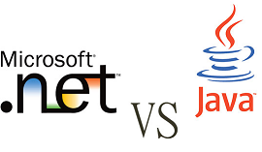

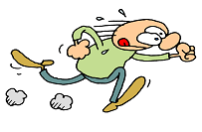


Development Platform

Slide 11
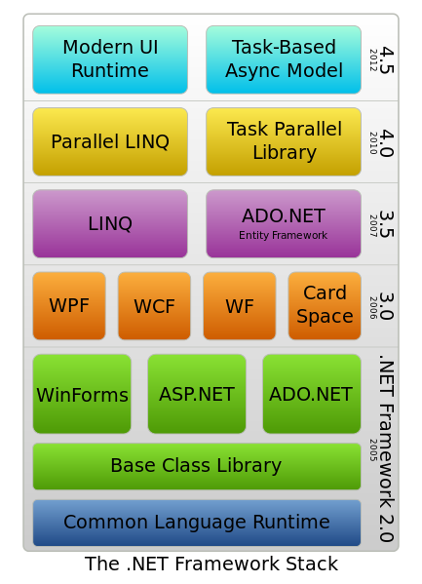
.NET
Core C# / C# Collection / LINQ,
Automation Tests with Visual Studio Unit Test,
ADO.NET / ORM / Entity Framework,
HTML5 / CSS3 / Javascript / JQuery,
ASP.NET / ASP.NET MVC

Slide 12
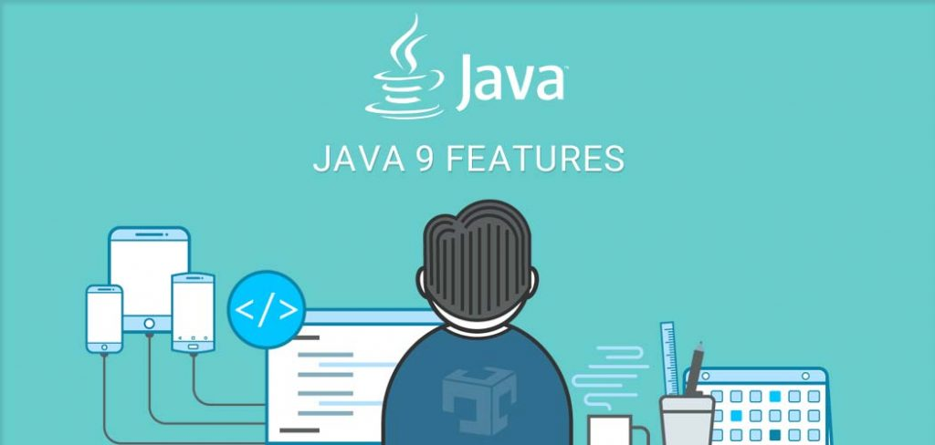
Java
Core Java / Java Collection Framework,
Automation Tests with JUnit,
JDBC / ORM / Hibernate 3.0,
HTML5 / CSS3 / Javascript / JQuery,
JSP Servlet / Spring / Spring MVC

Slide 13
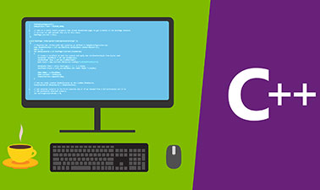
C++
Standard Template Library (STL),
File Processing, C++ Desktop Programming,
Windows API, User Controls, Hook, Shared Mem,
MPI, Error Handling / Debug Tracert Tracking,
Automation Test with CPPUnit

Slide 14
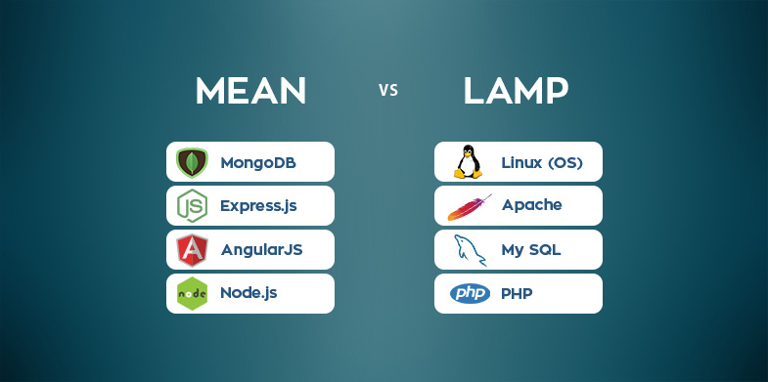
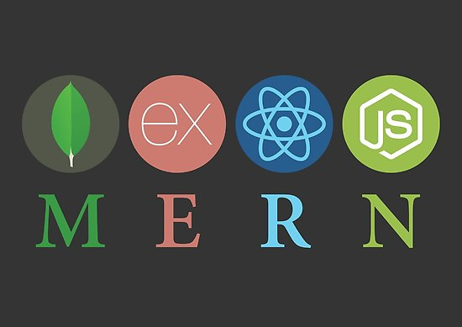

Technology Stacks

Slide 15
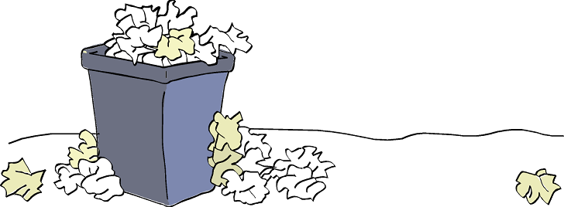
Software Penmanship: Writing Code
The letter-writing metaphor suggests that the software process relies on expensive trial and error rather than careful planning and design.

Slide 16

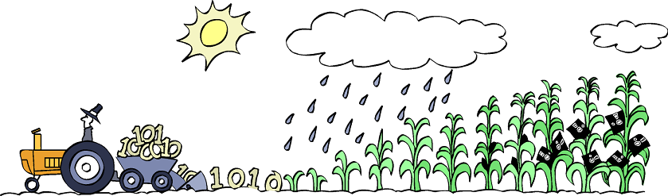
Software Farming: Growing a System
You design a piece, code a piece, test a piece, and add it to the system a little bit at a time.
The incremental technique is valuable, but the farming metaphor is terrible.
You don't have any direct control over (the weather) how the software develops.

Slide 17
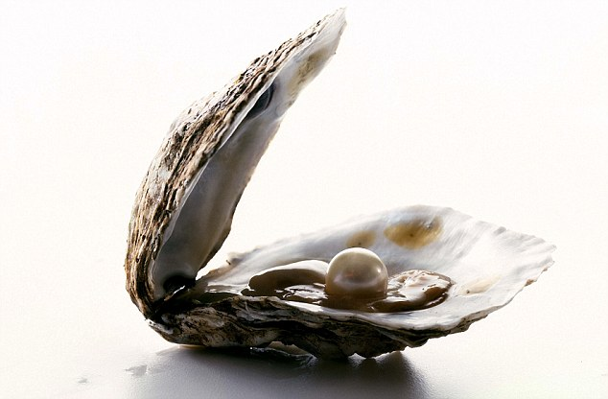
Software Oyster Farming: System Accretion
Other words closely related to accretion are "incremental," "iterative," "adaptive," and "evolutionary."
You first make the simplest possible version of the system that will run.
After you've formed the skeleton, little by little you lay on the muscle and skin.

Slide 18
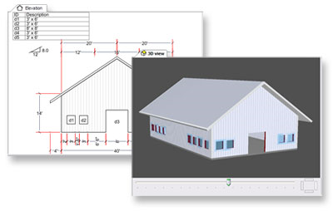

Software Construction: Building Software
It's compatible with the idea of software accretion and provides more detailed guidance.
Careful planning doesn't necessarily mean exhaustive planning or over-planning.

Slide 19
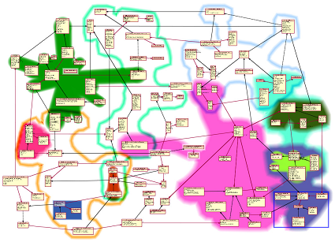

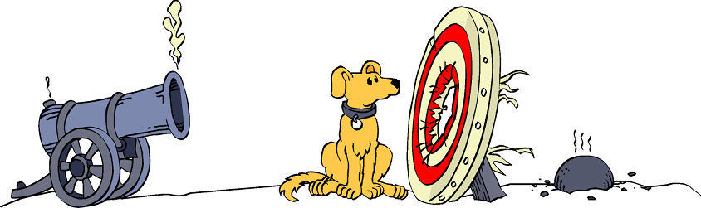
The Solution (aka The Architecture)

Slide 20

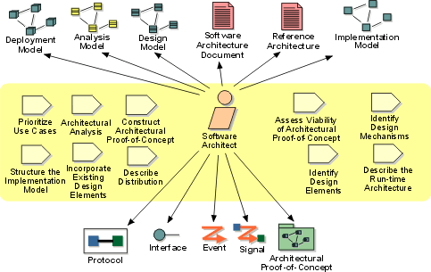


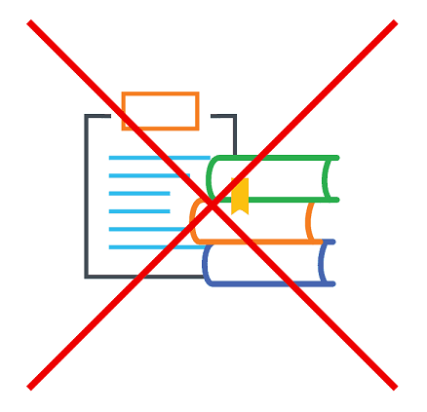
The Actual Solution (aka The Detailed Design)

Slide 21
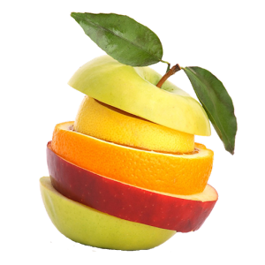
Combining Metaphors
You can use both the accretion and the construction metaphors.
You can use writing if you want to, and you can combine writing with driving, hunting for werewolves, or drowning in a tar pit with dinosaurs.
Use whatever metaphor or combination of metaphors stimulates your own thinking or communicates well with others on your team.

Slide 22

Thank You & See You Again

